Slide 1
AGU 2013
IN21D-07 :: The ES-DOC Project

Slide 2
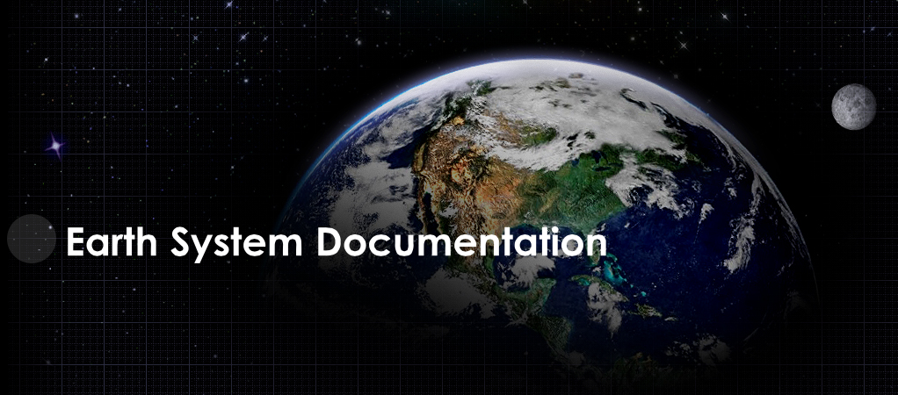


Slide 3
http://es-doc.org

Slide 4
#esdocumentation

Slide 5
Funders
IPSL (EU)
NOAA (US)
EX-ARCH (G8)
ISENES-2 (EU)

Slide 6
PI’s
Venkatramani Balaji (US - NOAA)
Cecelia DeLuca (US - NOAA)
Sébastien Denvil (EU - IPSL)
Eric Guilyardi (EU - IPSL)
Bryan Lawrence (EU - BADC)
Karl Taylor (US - PCMDI)

Slide 7
Core Team
Sylvia Murphy (US - NOAA)
Allyn Treshansky (US - NOAA)
Mark Greenslade (EU - IPSL)

Slide 8
Mission
Nurture a standards based eco-system in support of earth system documentation creation, analysis & dissemination.

Slide 9
Domains
@2013 :: Earth System Models
@2014 ? :: Earth System Observations

Slide 10
Process
Transparent
Documented
Iterative
Sustainable
International

Slide 11
Services
Engage scientific community
Nurture standards, e.g. CIM
Advocacy
Governance
Dissemination
Exploitation

Slide 12
Tools
Create
Search
View
Compare
Visualize

Slide 13
API
Publish
Search
Compare
Visualize

Slide 14
Online Presence
Splash Page
Quick Links
Tools
API

Slide 15
Demo
Search
View
Compare
Publish

